Slide 1
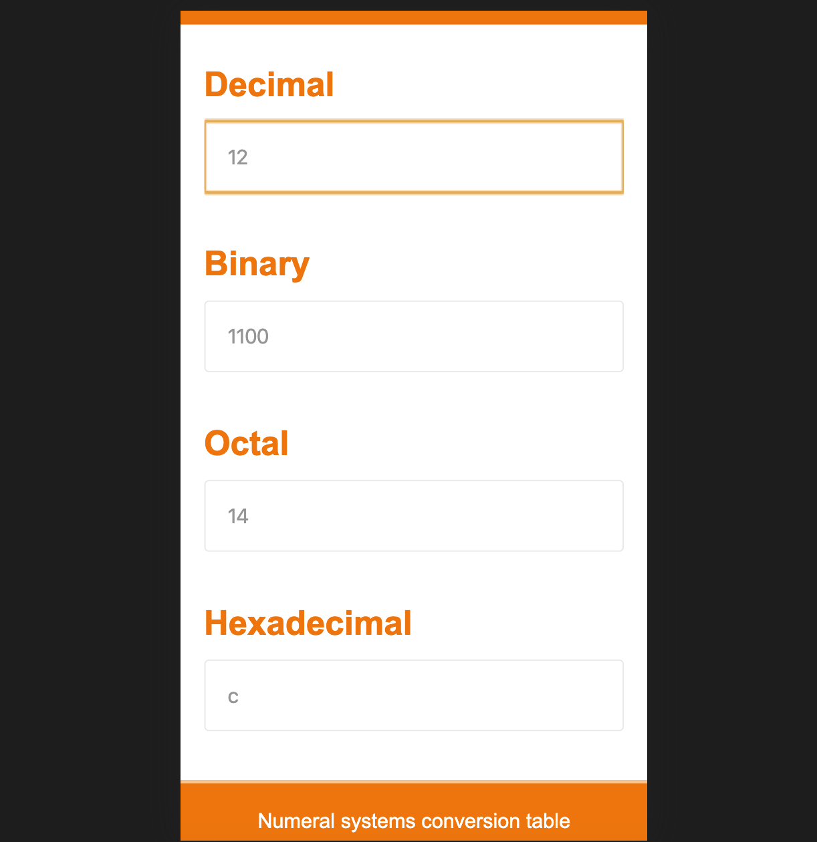
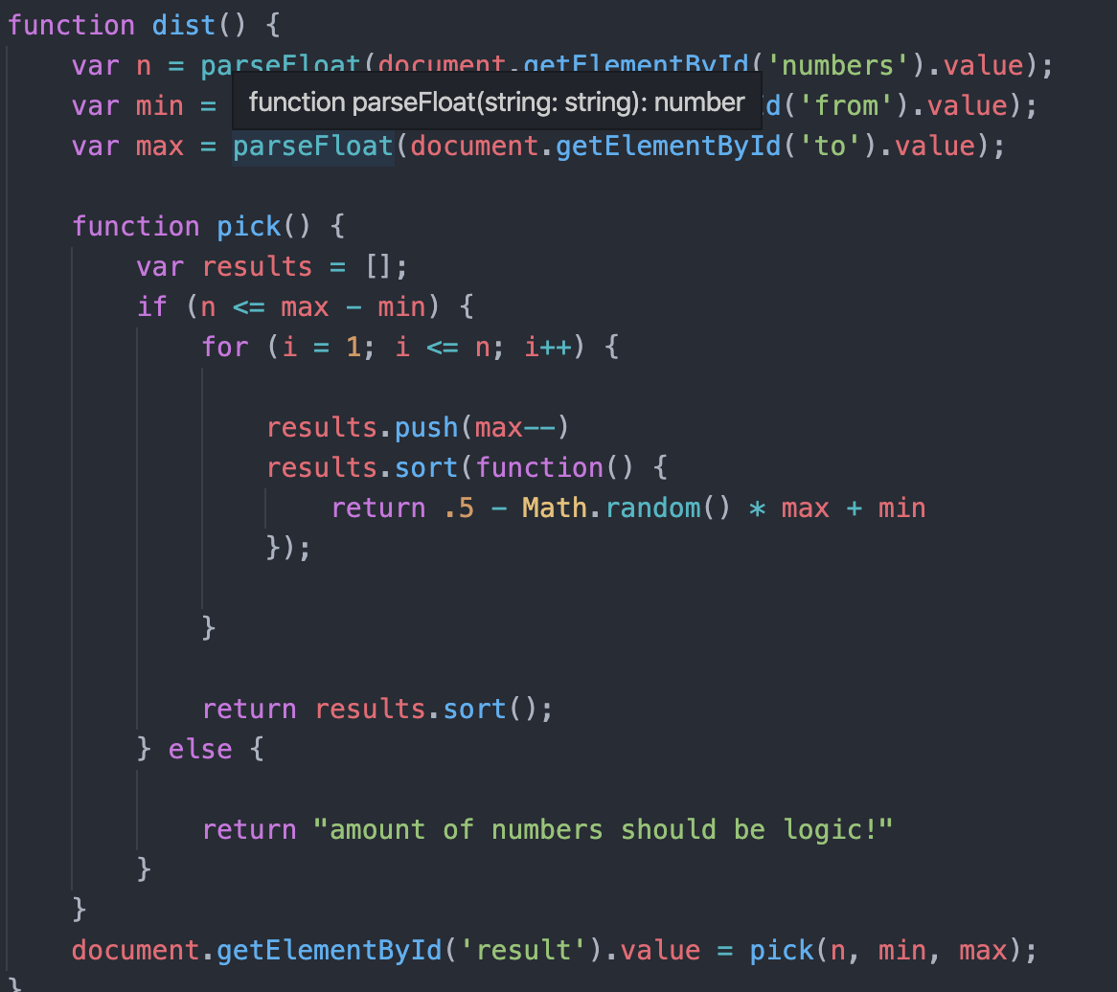
Math tool Web application
Abdeljalil Misbah, Jami Hannus, DIN19SP
Information Technology
Introduction
Project is to create a simple webpage with mathematical functions. Using Html, CSS and JavaScript.
Objectives
Main objective of the project was to combine the skills that were developed in JavaScript and Html into a greater entity. The project will improve the groups time management skills and group working practices.
The project was split in to 2 parts. The Html and CSS part. Then the JavaScript part. Html was used to create the interface of the webpage. JavaScript was used to calculate the functions. The final product will work as standalone web page, that could be used without network connection. Major aim was to get the mathematical functions calculating the tasks given by the user who’s communicating with the app using a device whether a mobile or a computer.
FIGURE 1. The website Diagram
It could be handled by restricting input or filtering the unwanted inputs. Then how to show the output of formulas in logical, easily comprehendible manner. The graphical aspect was a lesser priority then the functional parts of the project. The point was to concentrate on usability then style.
Methods
JavaScript was used as the backend language to program the mathematical functions with the inputs from Html input fields. CSS was used to improve the user experience. Functions would calculate automatically on input or when user pressed the button to execute the function.
FIGURE 2. Part of the Coding
Results
Overall the project was successful. The main obstacle was the handling of inputs and printing the tables.
The logic of the project was a success from the mathematical algorithms side. The main objective of the project was achieved. One answer to input problem would to require user to user, webpage keypad for the inputs to lessen the input amount variables.
FIGURE 3. The final UI on a mobile device
Conclusions
The project did improve learning and showed very well the areas what are important in project working. Also it became apparent the importance of planning. The web page itself was functional. So did meet the requirements of the project. Some improvements could be done for the user interface to allow more input from the functions.
Web Application Project
ECTS Credits: 15(End project)
Date of Publication: 2019, December.
Instructors: Johanna Talvensaari, Haverinen Lasse, Niva Anu, Kari Laitinen.

